Slide 1
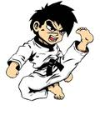
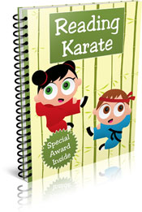
Reading Karate
The Rationale
This a fantastic incentive this year that we, as a school, are very excited about!
Just like the Japanese Martial Art, Reading Karate is about practising and persevering with a skill and working your way up through a series of bands/certificates.

Slide 2
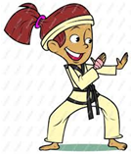
Karate Reading
Reading Karate Certificates
Every day we will check to see who has read at home or, for the youngest members of the school, who has shared a book with their family. Numbers of reads are totalled up and each Friday, in our Celebration Assembly, children who have achieved different numbers of reads are awarded with Reading Certificates.

Slide 3
READING KARATE RULES
Foundation Stage Sharing a book with an adult at home counts as a read. This could be your school reading book, library book or a bedtime story. An adult must sign your reading record. Only one read per day counts. | Infants Year 1 & 2 Sharing a book with an adult at home for 10 minutes or more counts as a read. This could be your school reading book, library book or a book from home. An adult must sign your reading record book. Only one read per day counts.

Slide 4
Reading Karate

Slide 5
Remember
Karate reading certificates are only for the children who are not on accelerated reader. Accelerated reader does provide its own certificates.

